Slide 1
Spark
Emanuele Della Valle
emanuele.dellavalle@polimi.it

Slide 2


Taming
Continuous massive flows than you cannot stop with Data Stream Mng. Systems

Slide 3

Apache
Unified analytics engine for big data processing, with built-in modules for streaming, SQL, machine learning and graph processing

Slide 4

vs.
Apache hadoop is disk-centric
Apache Spark is RAM-centric

Slide 5
The architecture of

Slide 6
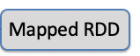

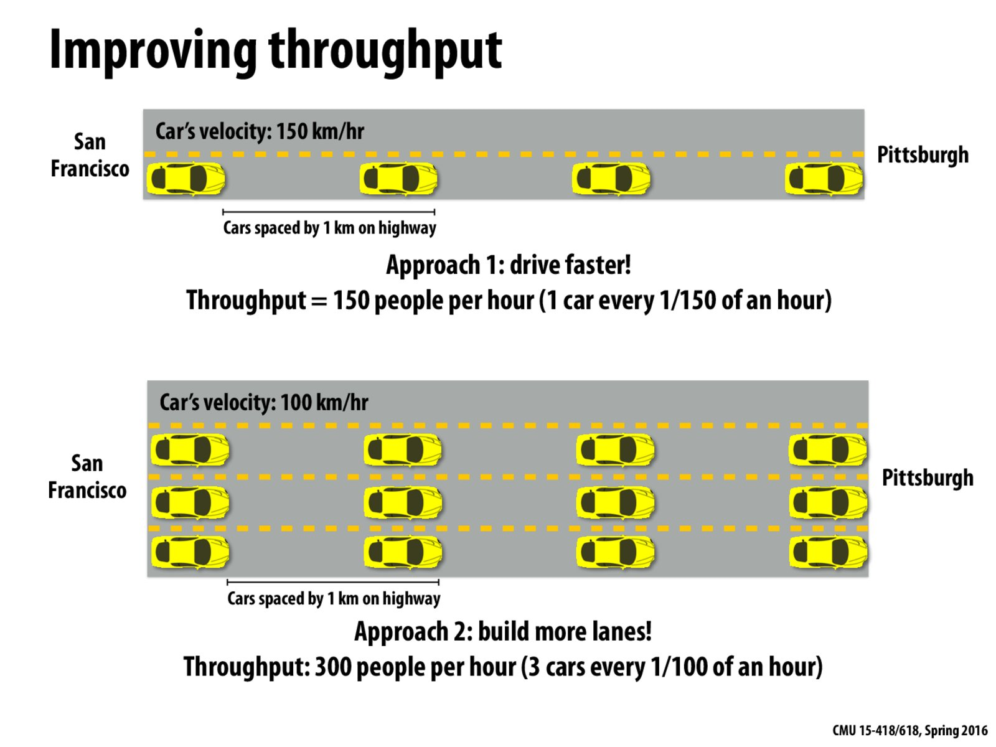
RDD
Definition
Resilient: Fault-tolerant
Distributed: Computed across multiple nodes
Dataset: Collection of partitioned data
Characteristics
Immutable once constructed
Track lineage information
Logical view: single dataset
Physical view: 1 or more partitions
RDD

Slide 7
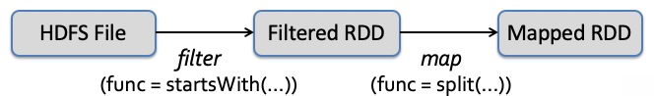
Transformations - logical view
RDD are immutable, transformations create new RDD
msgs = (textFile.filter(lambda s: s.startsWith(“ERROR”))
.map(lambda s: s.split(“\t”)[2]))
lineage

Slide 8
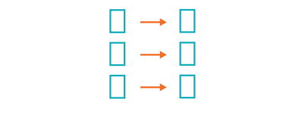
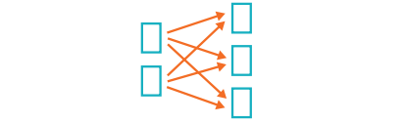
Transformations – physical view
Narrow Transformations
The data required to compute the records in a single partition reside in at most one partition of the parent RDD
map()
filter()
…
Wide Transformations (shuffles)
The data required to compute the records in a single partition may reside in many partitions of the parent RDD
groupBy(..).sum()
distinct()
…

Slide 9
Actions – logical view
Actions either return a result or write to disc
For example:
The number of records in the case of count()
An array of objects in the case of collect() or take(n)

Slide 10
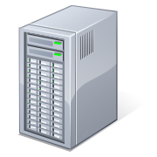
Actions – system view
Base RDD
lines = sc.textFile(“hdfs://...”)
errors = lines.filter(lambda s: s.startswith(“ERROR”))
messages = errors.map(lambda s: s.split(“\t”)[2])
results
Worker
messages.filter(lambda s: “mysql” in s).count()
tasks
Block 1
Transformed RDD
Action
Driver
Worker
Worker
Block 2
Block 3
Notes:
Add “variables” to the “functions” in functional programming

Slide 11
Caching (where the magic is!)
lines = spark.textFile(“hdfs://...”)
errors = lines.filter(lambda s: s.startswith(“ERROR”))
messages = errors.map(lambda s: s.split(“\t”)[2])
messages.cache()
Cache 1
results
Worker
messages.filter(lambda s: “mysql” in s).count()
tasks
Block 1
Driver
messages.filter(lambda s: “php” in s).count()
. . .
Cache 2
IN PRACTICE
Full-text search of Wikipedia
60GB on 20 EC2 machine
0.5 sec vs. 20s for on-disk
Worker
Cache 3
Worker
Block 2
Block 3
Notes:
Add “variables” to the “functions” in functional programming

Slide 12
Laziness By Design
Fundamental to Apache Spark are the notions that
Transformations are LAZY
Actions are EAGER
NOTE: We saw this play out in the previous slide when we run multiple transformations back-to-back, and no job was triggered until the first action was requested

Slide 13
DataFrame
Definition
Immutable Data with named columns
Built on RDDs
Characteristics
User-friendly API
Uniform APIs across languages (Scala, Java, Python, R, and SQL)
Improved performance via optimizations (Tungsten and Catalyst)

Slide 14
DataFrame code snippet
An Apache Spark code snippet using SQL and DataFrames to query and join different data sources
# Read a CSV
userDF = spark.read.csv(" … /userData.csv")
# ... or Use DataFrame APIs and register a temp view
middleageSmokers = userDF.filter(col("smoker")=="Y").filter(col("age")>40)
middleageSmokers.createOrReplaceTempView("middleageSmokers")
# ... read a CSV and register a temp view
spark.read.json(" … /part-00000.json.gz").createOrReplaceTempView("iot_stream")
# ... execute SQL query or ...
spark.sql("SELECT avg(calories_burnt) FROM iot_stream JOIN middleageSmokers ON …")

Slide 15
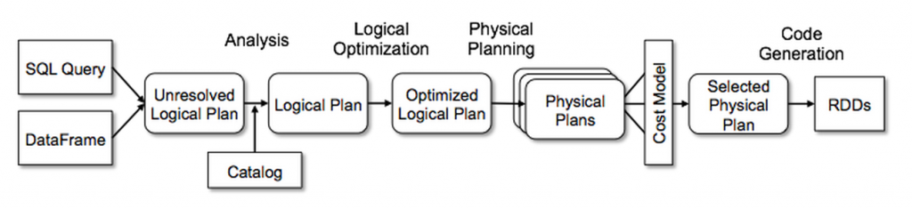
Under the Hood: Catalyst
Generates optimal RDD code from the user request

Slide 16
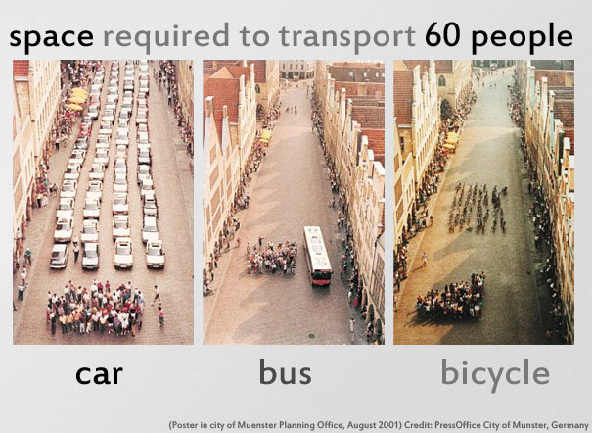
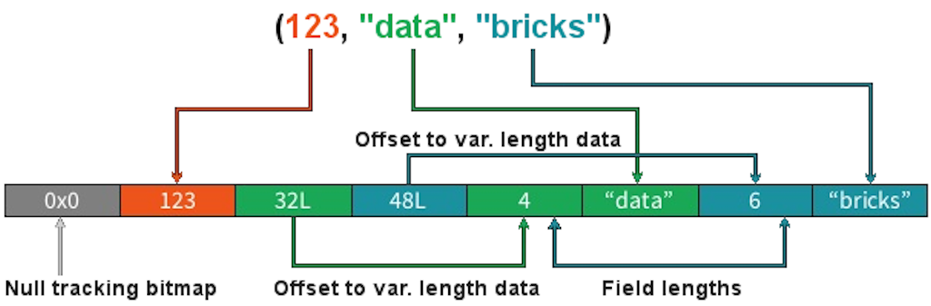
Under the Hood: Tungsten Binary Format
Off-heap, compact and efficient in-memory storage row format

Slide 17
Spark at work – Jobs, Stages and Tasks
The DAG Scheduler is the scheduling layer of Spark
It transforms a logical execution plan into a physical one (a Job) considering data locality and partitioning (to avoid shuffles)
Each Job is a DAG of Stages which are broken down into Tasks
A:
B:
F:
Stage 1
groupBy
C:
D:
E:
join
Stage 2
map
filter
Stage 3
= RDD
= cached partition

Slide 18
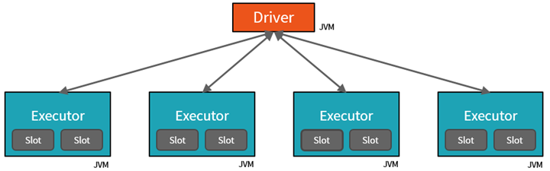
Spark at work - components
A Spark cluster includes
One Driver running the user application
Multiple Executors (typically, one instance per node) with multiple Slots (typically, one per core/CPU)

Slide 19
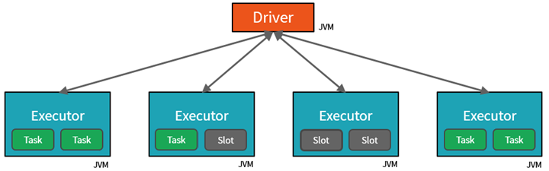
Spark at work – runtime view
The Driver assigns Tasks to Executors’ Slots for parallel execution
The Driver also makes sure that all tasks of a Stage are executed before starting any task of the next stage

Slide 20

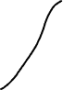
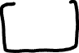
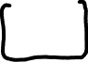
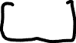


Connecting Spark to kafka

Slide 21
Scaling stream processing with Kafka and Spark
Emanuele Della Valle
emanuele.dellavalle@polimi.it

